Slide 1
IT5302 SOFTWARE ENGINEERING Class 19

Slide 2
Creating A Behavioral Model
The behavioral model indicates how software will respond to external events or stimuli.
To create the model, you should perform the following steps:
Evaluate all use cases to fully understand the sequence of interaction within the system.
Identify events that drive the interaction sequence and understand how these events relate to specific objects.
Create a sequence for each use case.
Build a state diagram for the system.
Review the behavioral model to verify accuracy and consistency.

Slide 3
Identifying Events with the Use Case
Use case represents a sequence of activities that involves actors and the system.
An Event occurs whenever the system and an actor exchange information.
A use case is examined for points of information exchange.
An actor should be identified for each event, the information that is exchanged should be noted and any conditions or constraints should be listed.
Once all events have been identified, they are allocated to the objects involved.
Objects can be responsible for generating events or recognizing events that have occurred elsewhere.

Slide 4
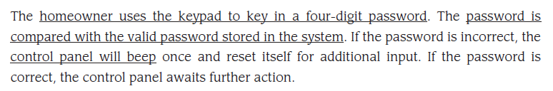
Consider the use case for a portion of the SafeHome security function.
The underlined portions of the use case scenario indicate events.

Slide 5
State Representations
In the context of behavioral modeling, two different characterizations of states must be considered:
The state of each class as the system performs its function.
The state of the system as observed from the outside as the system performs its function.
The state of a class takes on both passive and active characteristics
A passive state is simply the current status of all an object’s attributes.
The active state of an object indicates the current status of the object as it undergoes a continuing transformation or processing.
An event (trigger) must occur to force an object to make a transition from one active state to another.

Slide 6
Two different behavioral representations:
State diagrams for analysis classes- indicates how an individual class changes state based on external events.
Sequence diagrams- shows the behavior of the software as a function of time.

Slide 7
State diagram for analysis classes
One component of a behavioral model is a UML state diagram that represents active states for each class and the events that cause changes between these active states.
The active state model provides useful insight into the ‘life history’ of an object, it is possible to specify additional information to provide more depth in understanding the behavior of an object.
In addition to specifying the event that causes the transition occur, you can specify a guard and an action.

Slide 8
A guard is a Boolean condition that must be satisfied in order for the transition to occur.
In general, the guard for a transition usually depends upon the value of one or more attributes of an object.
In other words, the guard depends on the passive state of the object.
An action occurs concurrently with the state transition or as a consequence of it and generally involves one or more operations.

Slide 9
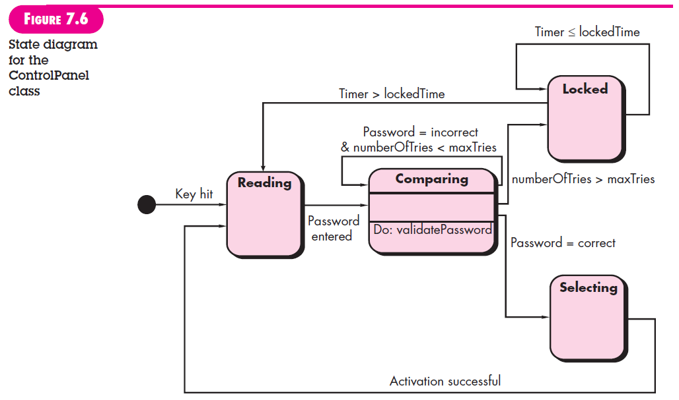

Slide 10
Sequence diagrams
The second type of behavioral representation, called a sequence diagram in UML, indicates how events cause transitions from object to object.
Once events have been identified by examining a use case, the modeler creates a sequence diagram- a representation of how events cause flow from one object to another as a function of time.
Sequence diagram is a shorthand version of the use case.
It represents key classes and the events that cause behavior to flow from class to class.

Slide 11
Once a complete sequence diagram has been developed, all of the events that cause transitions between system objects can be collated into a set of input events and output events (from an object).
This information is useful in the creation of an effective design for the system to be built.

Slide 12
